Slide 1
Census Reporting System (CRP)

Slide 2
Under the guidance of :
Project Team:
Akshay Devkate
Kanmani k
Poonam Wathodkar
Roseleena Bharali
Laxmi Nirmal
Shivangi
Mr. Rahul Kulkarni

Slide 3
Project Objectives:
Development of a Census Reporting System(CRP)
The purpose of this project is to gather information about general population in order to present a full and reliable picture of population in Cities- its Demographic and housing conditions, social and economic characteristics.

Slide 4
Project Flow
Heterogeneous sources i.e.
Operational data(Excel,
Flat files)
SSIS
Extract
Transform
D
A
T
A
S
E
T
Reports Based On Dataset
Data Warehouse
Load

Slide 5
Source Data
Person ID
Door number
Gender
DOB
Current Marital Status
Religion
Caste
Disability
Type of Disability
Literacy Status
Current Status of Attendance
Highest Education Level
Occupation
Nature of Industry
Sector
Salary

Slide 6
Source Data
Mode of Travelling
Children Surviving
Children Ever Born
Number of Expired in last 10 years
Type of House
Pan Card
Ration Card
Adhar Card
Area
City

Slide 7
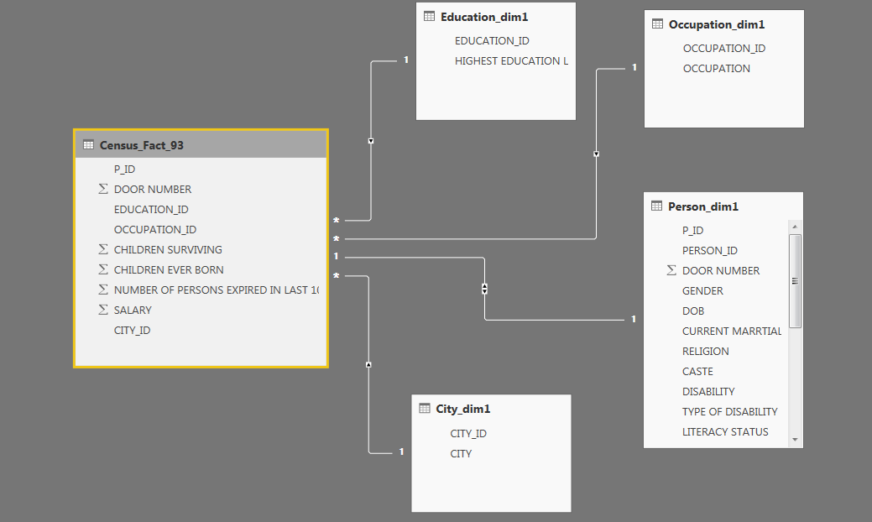
Data Ware House Schema

Slide 8
Staging Tables
False True
Source(Census data)
Data Conversion
Expression
(Upper Trim)
Aggregate
Valid Conditions
Union All
Staging Table
Error Table

Slide 9
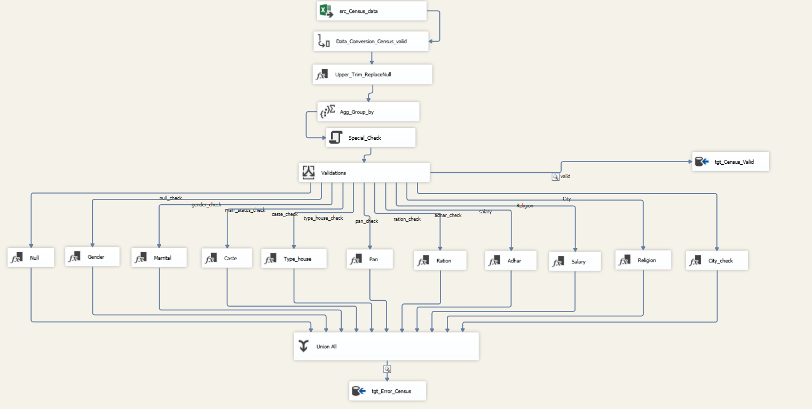
Creation of Staging Table

Slide 10
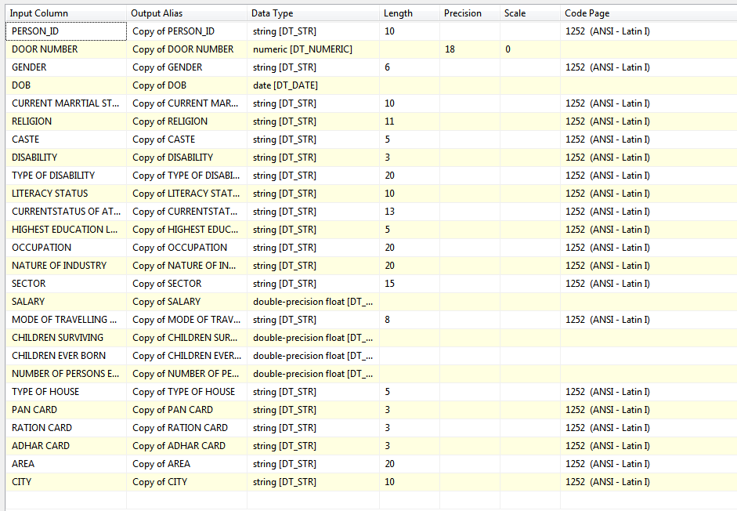
Data Conversion

Slide 11
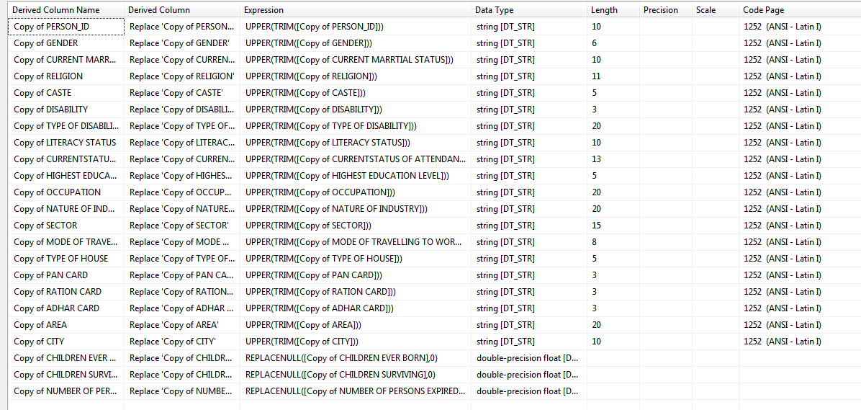
Upper Trim and Replace Null

Slide 12
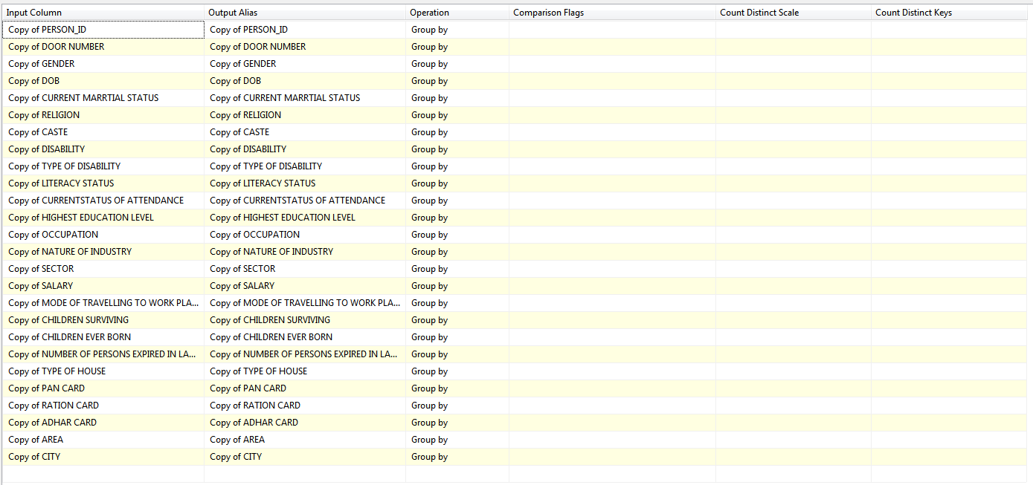
Aggregate

Slide 13
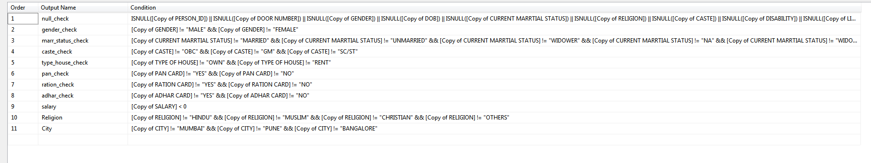
Validation check

Slide 14
Populate Tables
City Dimension Table
Education Dimension Table
Occupation Dimension Table
Person Dimension Table
Fact Table

Slide 15
Dimension Tables
OLEDB
Staging
Cleaned Data Table
Look Up
(Target Table)
City Dimension Table
Look Up
(Target Table)
Education Dimension Table
Look Up
(Target Table)
Occupation Dimension Table
Look Up
(Target Table)
Person Dimension Table

Slide 16
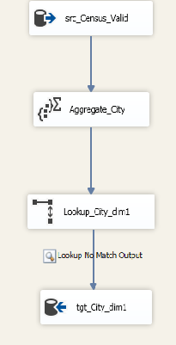
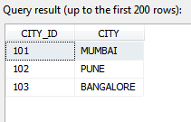
City Dimension Table

Slide 17
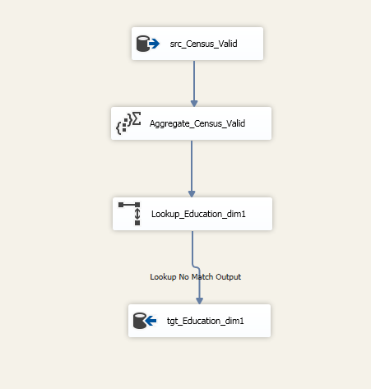
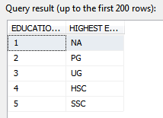
Education Dimension Table

Slide 18
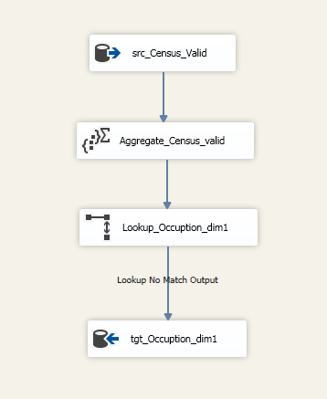
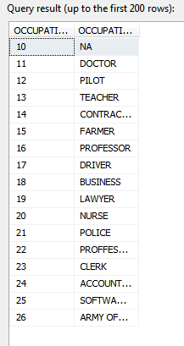
Occupation Dimension Table

Slide 19
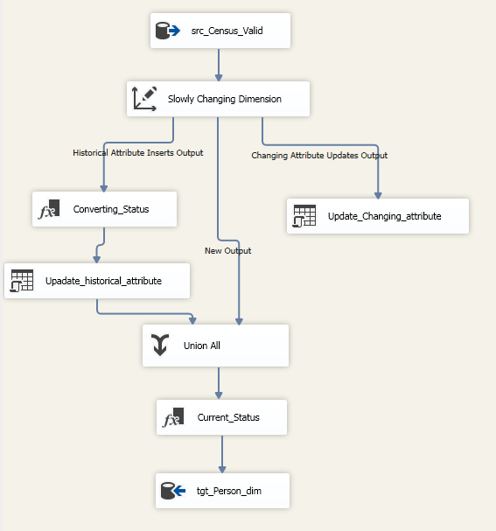
Person Dimension Table

Slide 20
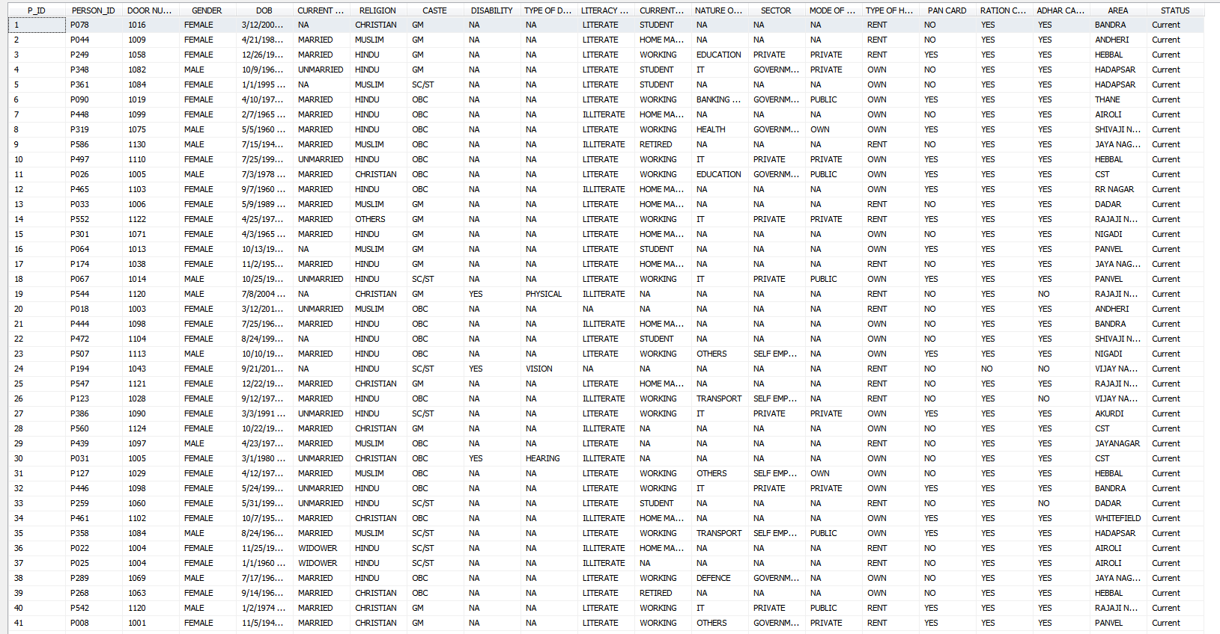

Slide 21
Populating Fact Table
City_dim1
Staging
Table
(Valid_Census_93)
Fact Table
(Census_Fact_93)
Education_dim1
Occupation_dim1
Person_dim1

Slide 22
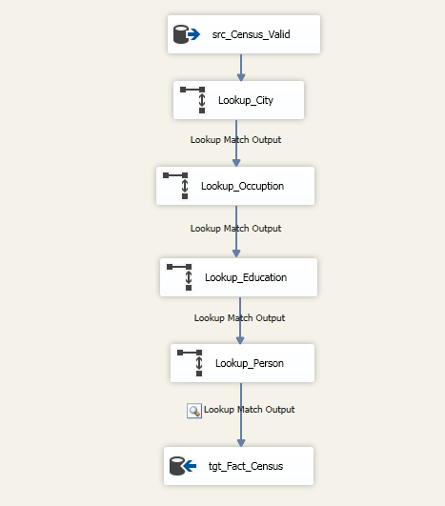
Fact Table

Slide 23
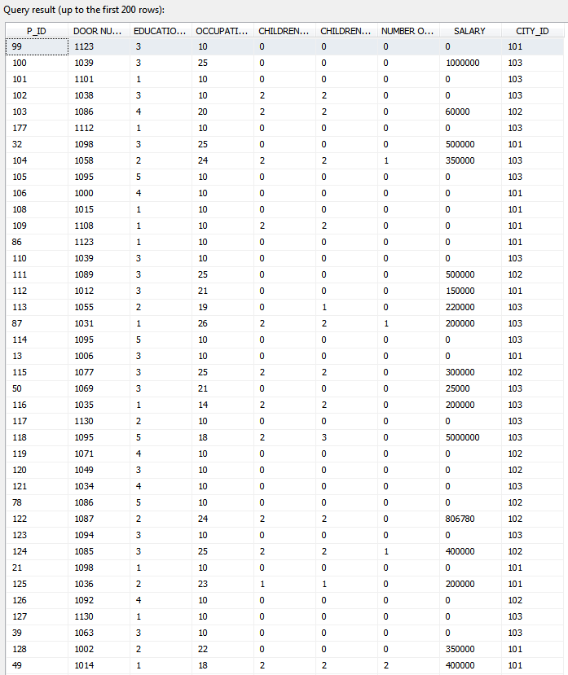
Fact table data

Slide 24
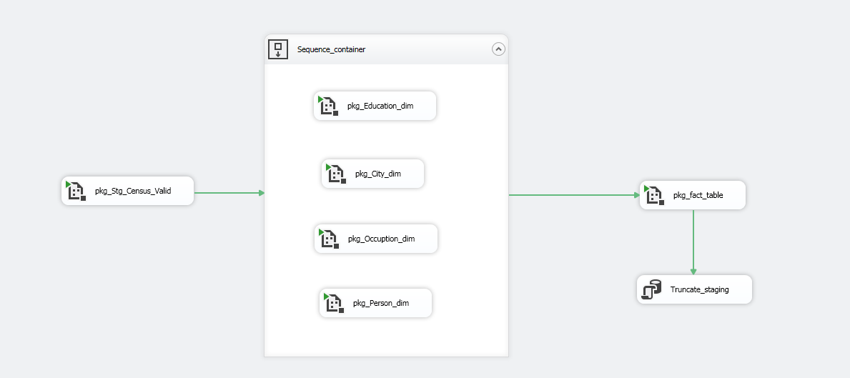
Automation

Slide 25
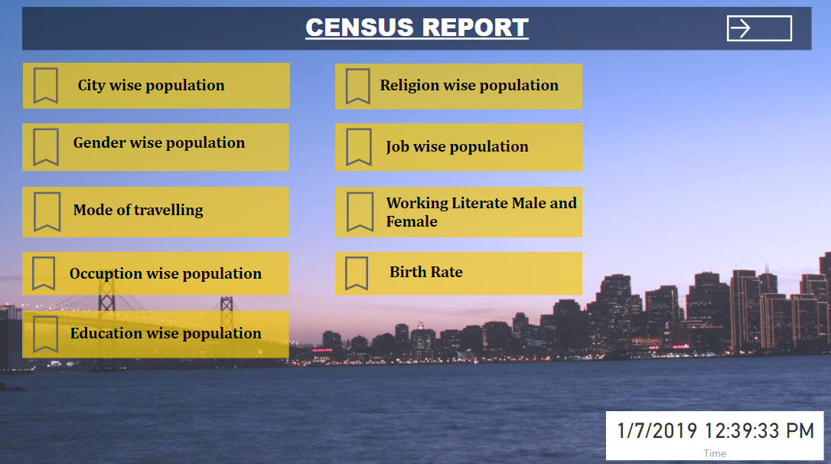

Slide 26
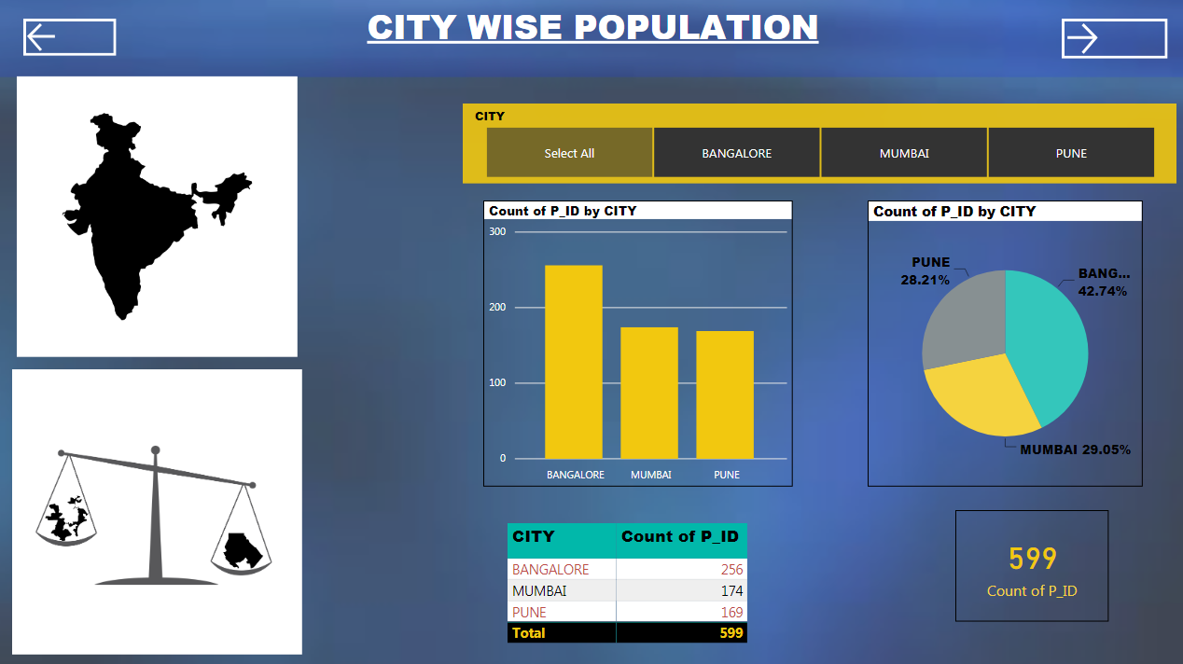

Slide 27
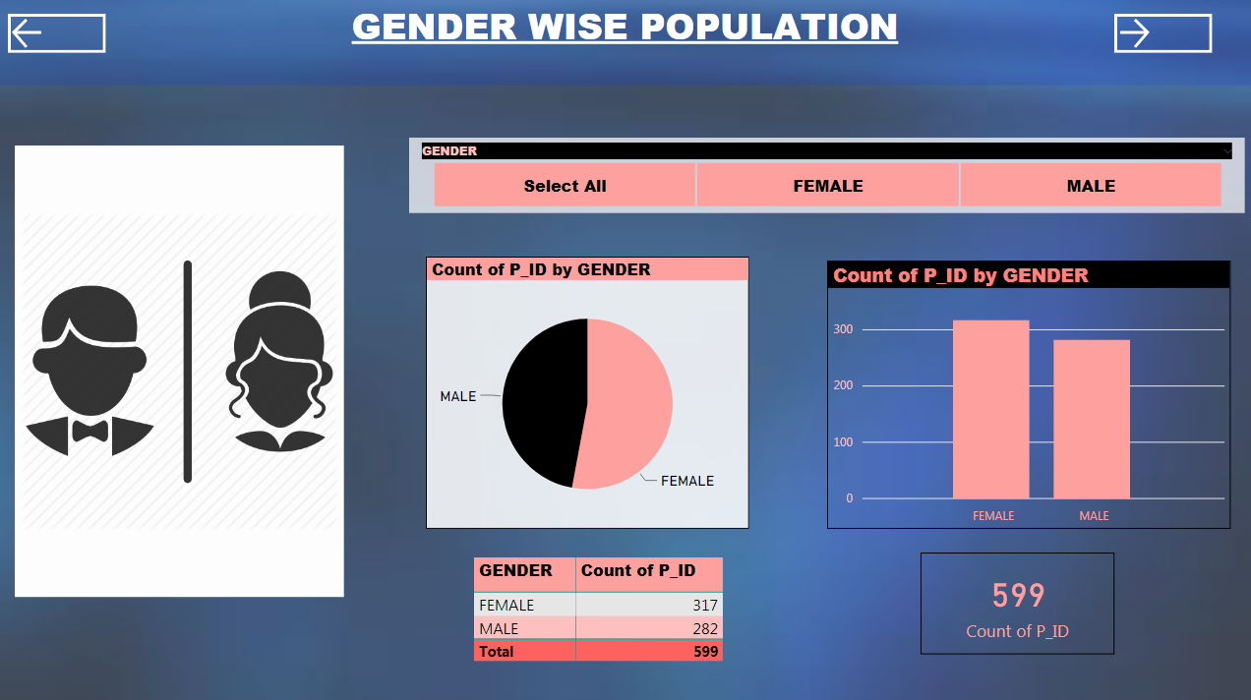

Slide 28
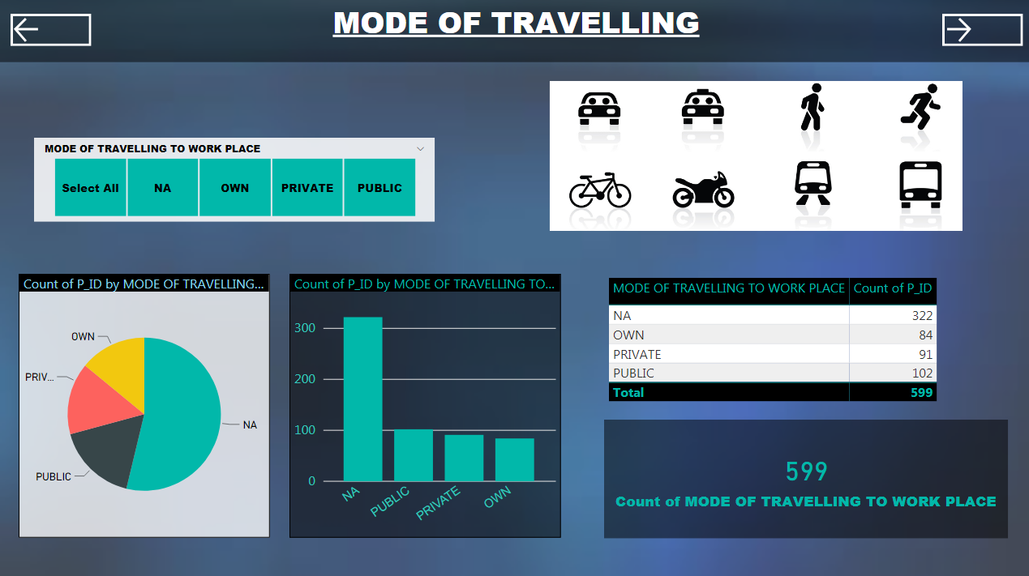

Slide 29
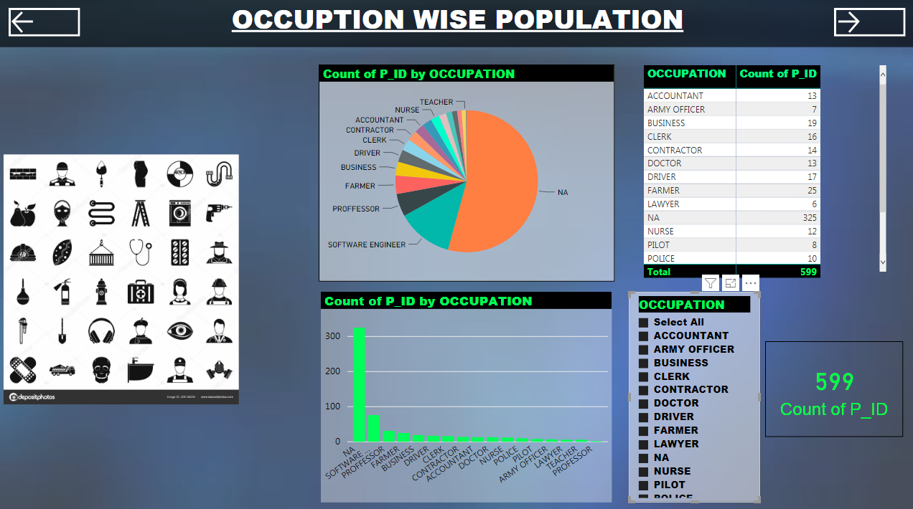

Slide 30
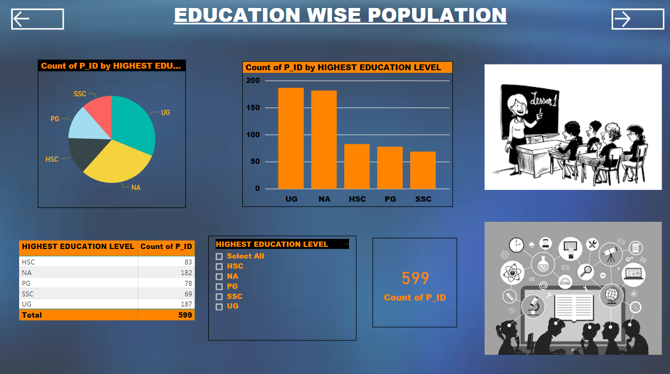

Slide 31
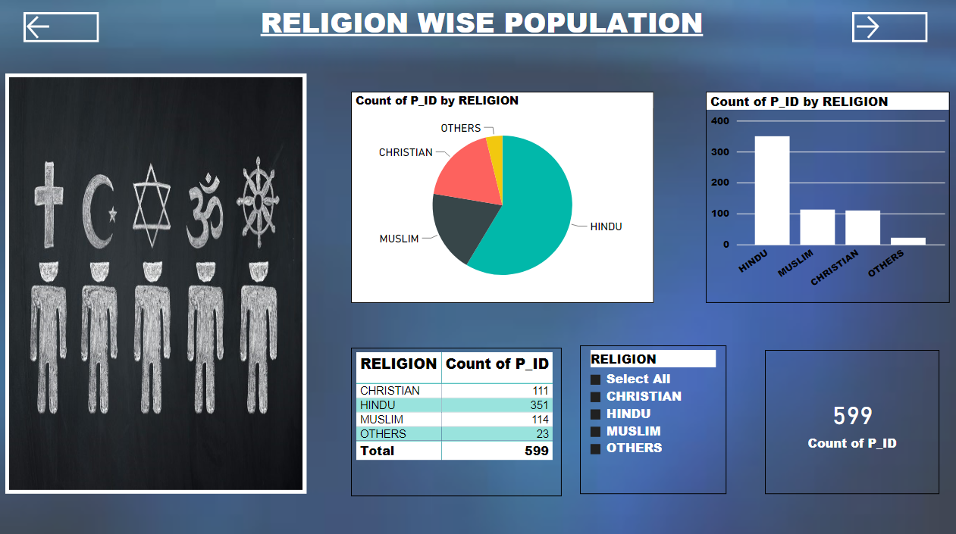

Slide 32
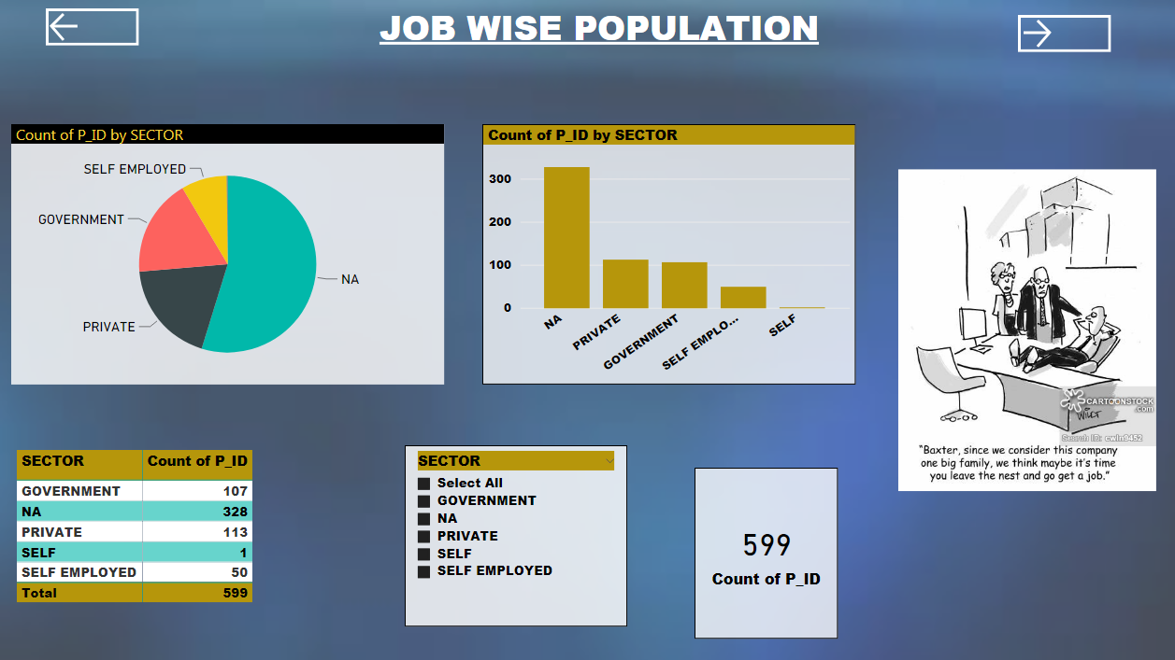

Slide 33
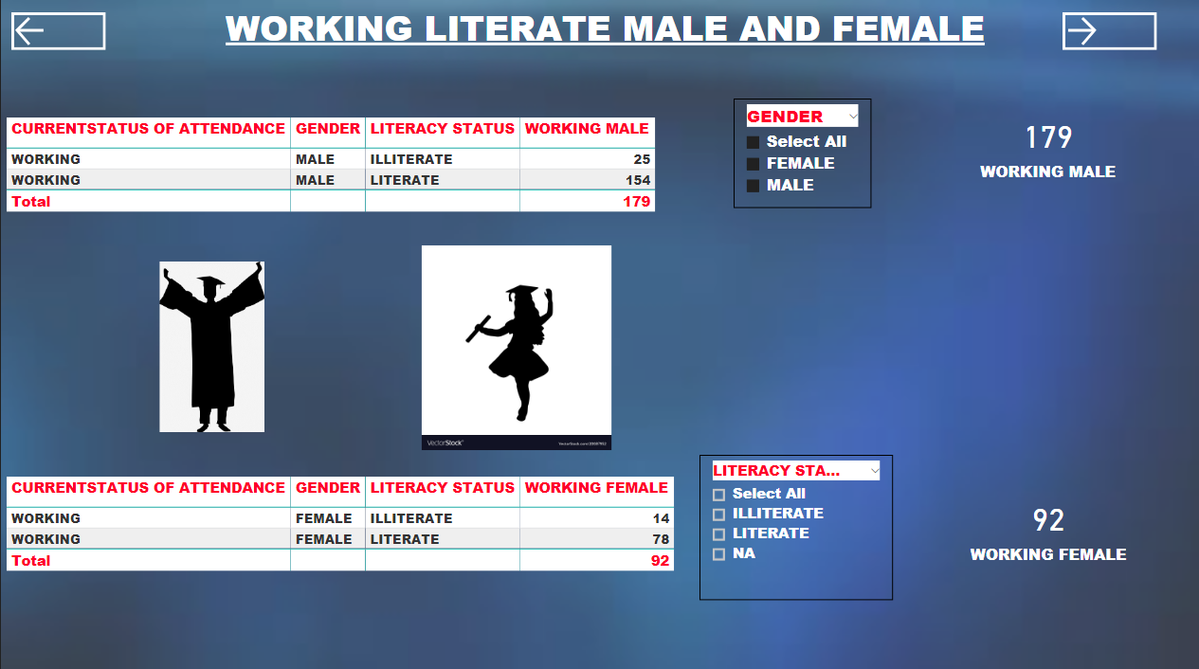

Slide 34
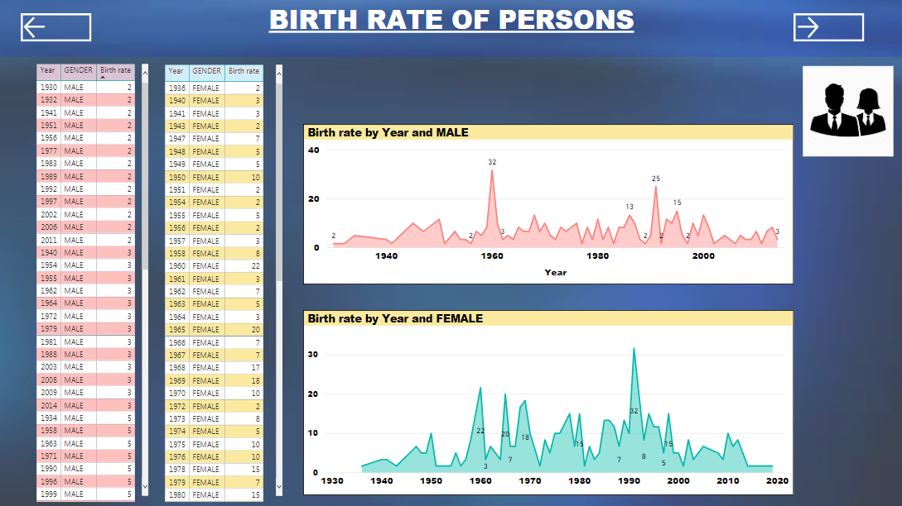

Slide 35

ANY QUESTIONS

Slide 36
Thank You

